Slide 1

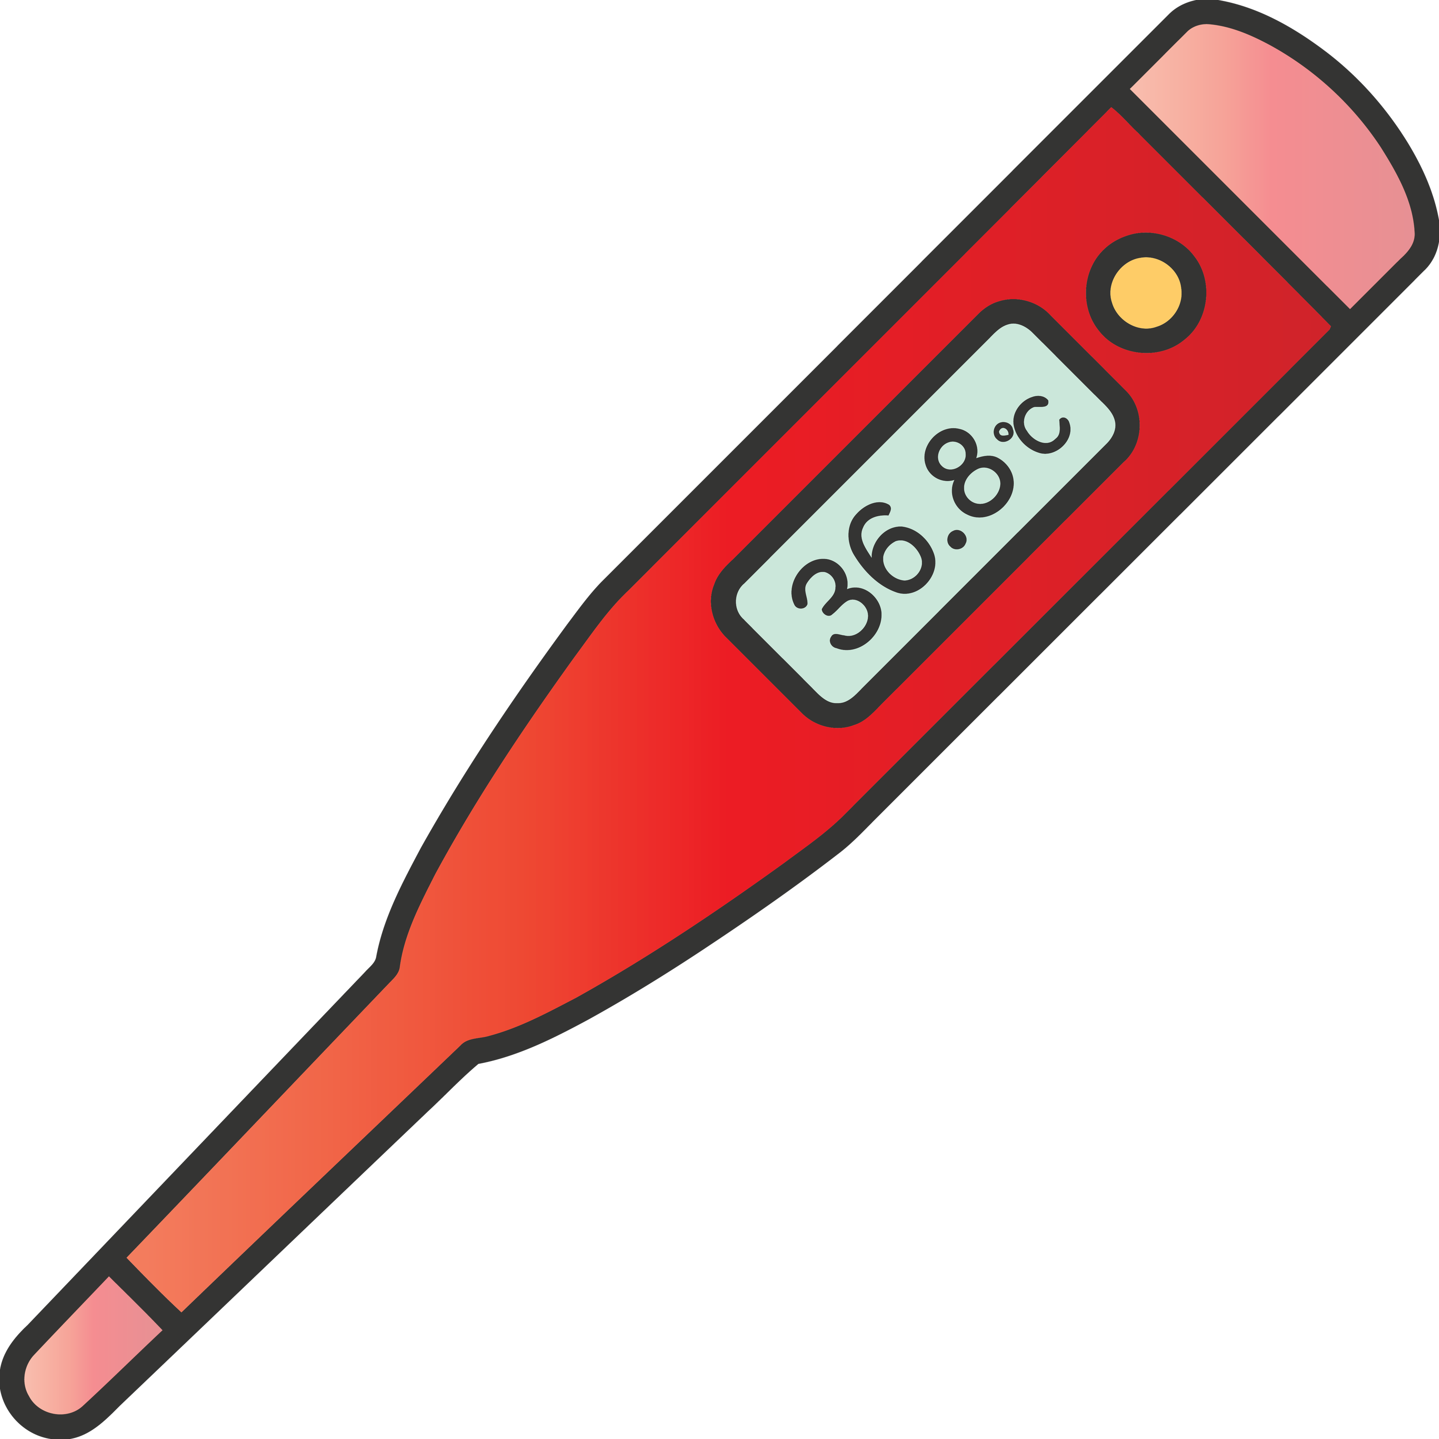



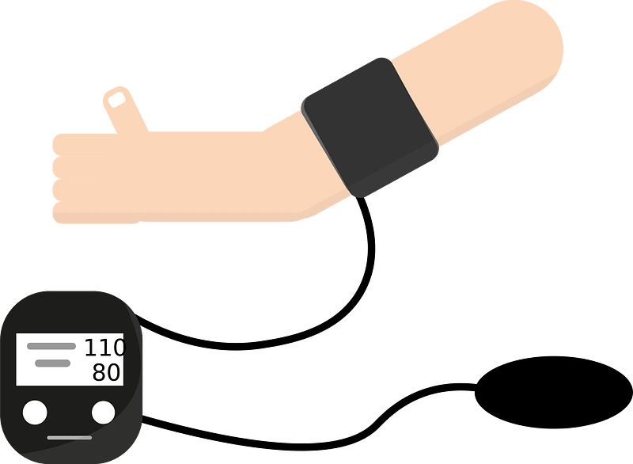
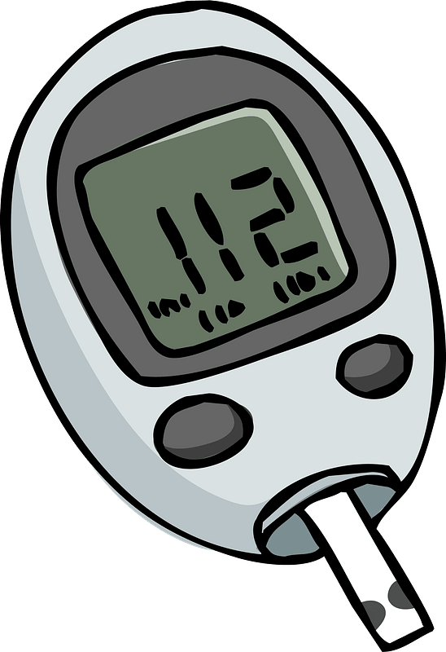
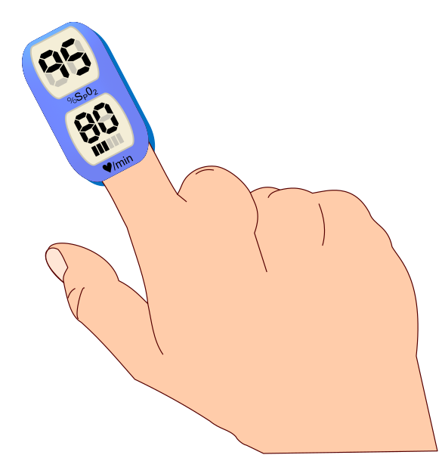
E
C
A
L
M
L
Notes:
1. Intro
2. Wearables + Metrics
3. POD (SOLID) Health Professional
4. AI – personal approach

Slide 2

Of adults in Flanders suffer from major psychological problems
20 %

Slide 3
Of adults in Flanders suffer from major psychological problems
20 %
Notes:
https://www.vrt.be/vrtnws/nl/2024/02/05/psychische-stoornissen-in-vlaanderen/

Slide 4
On average before they start searching for help
10 years

Slide 5
10 years

Slide 6


01/02
02/02
03/02
04/02
05/02
06/02
07/02
08/02
09/02
10/02
11/02
10082 steps
11997 steps
11008 steps
12762 steps
13254 steps
11284 steps
3892 steps
2243 steps
487 steps
376 steps
546 steps
2119 kcal
2102 kcal
1976 kcal
2334 kcal
1944 kcal
2098 kcal
2524 kcal
2632 kcal
?
?
?
😊
😊
😊
😊
😊
😊
😊
😐
😐
🙁
🙁

Slide 7
01/02
02/02
03/02
04/02
05/02
06/02
07/02
08/02
09/02
10/02
11/02
10082 steps
11997 steps
11008 steps
12762 steps
13254 steps
11284 steps
3892 steps
2243 steps
487 steps
376 steps
546 steps
2119 kcal
2102 kcal
1976 kcal
2334 kcal
1944 kcal
2098 kcal
2524 kcal
2632 kcal
?
?
?
😊
😊
😊
😊
😊
😊
😊
😐
😐
🙁
🙁

Slide 8
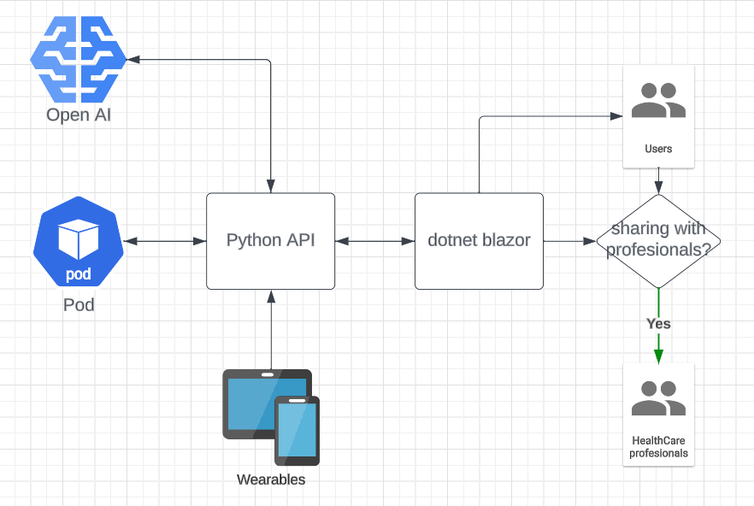

Slide 9
DATA POD
Medical professional
Partners Health Care / Insurance
E
C
A
L
M
L
Wearables
Environmental
Habit tracking

Slide 10
Data collection
Partnerships with Health care
Early detection and reach out

